Slide 1
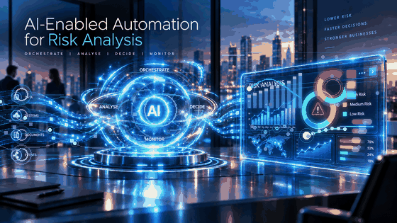
ISFS614 - Digital Banking & Trends

Slide 2
Agentic AI Risk Assessment Workflow Orchestration
Agentic AI Conceptual Design
Business Scenario
Business Requirements
Logical Design
Agentic AI Risk Assessment Workflow (Tasks 1–7)
Lab Flow
  Lab 1 – Create Agent-1 (Tasks 1 – 4)
  Lab 2 – Create Agent-2 & Agent-3 (Tasks 5 – 6)
  Lab 3 – Create Agentic AI Orchestrator (Task 7)
Lab Deliverables
  Lab 1 – R1 Customer Profile Risk Report
  Lab 2 – R2 Transaction Pattern Risk Report, and R3 Regulatory Screening Report
  Lab 3 – R4 Agentic AI Recommendation Report and Management Risk Dashboard
Lab setup

Slide 3
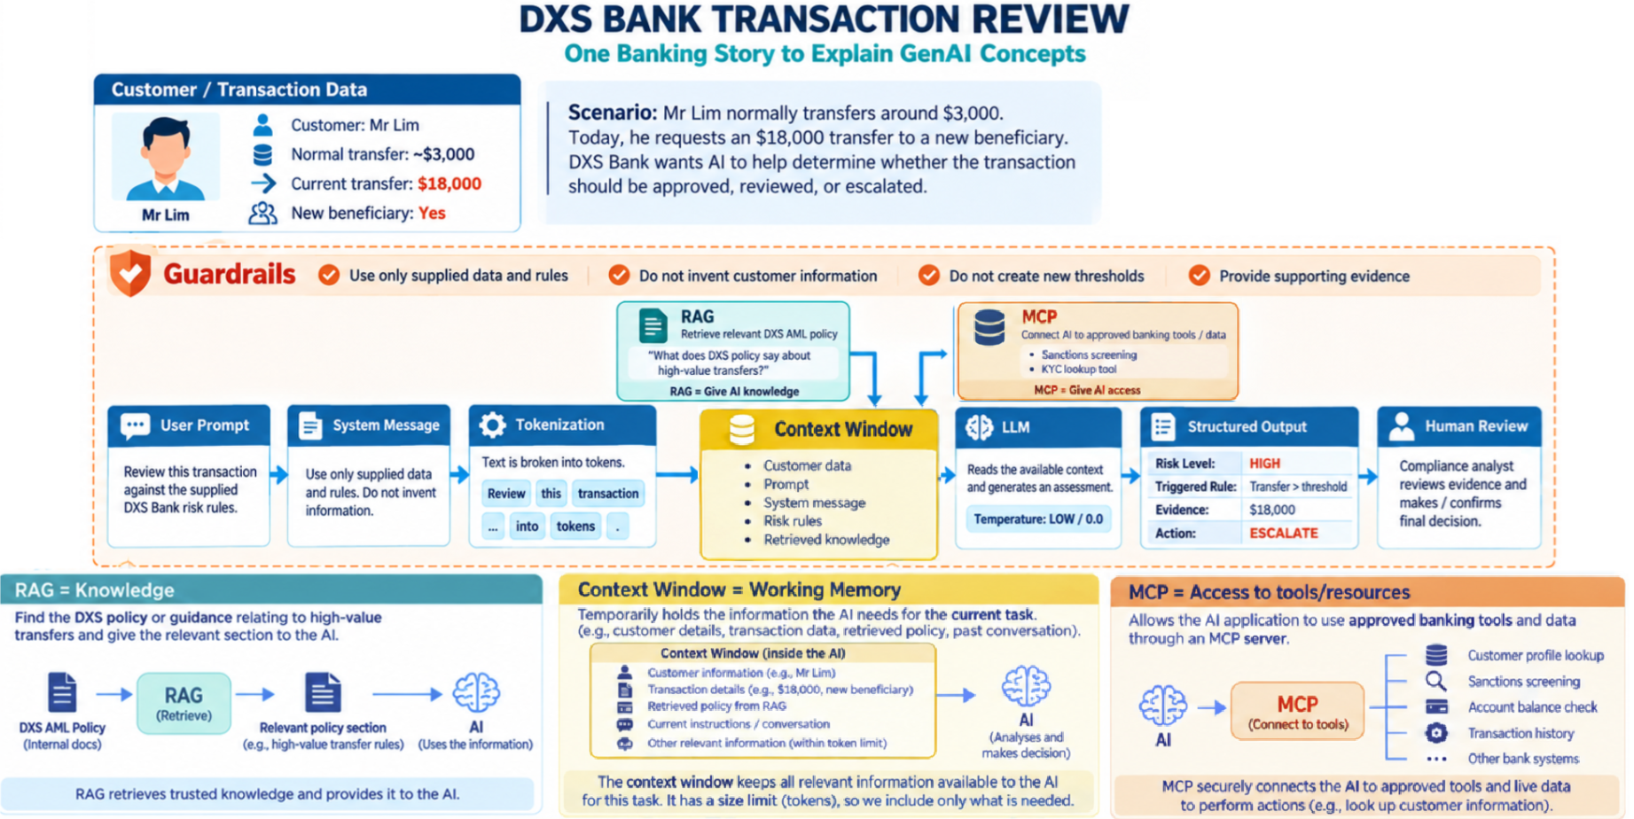
Agentic AI Conceptual Design
AI & GenAI Concepts Recap

Slide 4
Terminology | Meaning | DXS Bank Example
Guardrails | Rules and restrictions that define what the AI is allowed and not allowed to do. | DXS Bank tells the AI: use only supplied data and rules, do not invent customer information, do not create new thresholds, and provide supporting evidence.
User Prompt | The question or task that the user gives to the AI. | “Review this transaction against the supplied DXS Bank risk rules.”
System Prompt / System Message | Instructions that tell the AI how it should behave while performing the task. | “Use only supplied data and rules. Do not invent information.”
Token | A small unit of text that an AI model processes. A word may be represented by one or more tokens. | The instruction “Review this transaction” is broken into smaller units for the model to process.
Tokenization | The process of breaking text into tokens before it is processed by the model. | Review this transaction → smaller tokens that can be processed by the LLM.
Context Window | The limited amount of information the LLM can work with at one time — conceptually, its working memory for the current task. | The context window contains Mr Lim's details, transaction data, system instructions, DXS risk rules and the relevant policy retrieved through RAG.
RAG – Retrieval-Augmented Generation | A method that retrieves relevant information from an external knowledge source and gives it to the AI before it generates its answer. | RAG searches DXS Bank's AML policy for guidance on high-value transfers and provides the relevant section to the AI.
MCP – Model Context Protocol | A standard way for AI applications to connect to external tools, data and resources. | MCP allows the DXS Bank AI application to connect to approved services such as sanctions screening and KYC lookup.
LLM – Large Language Model | The AI model that processes the available instructions and context and generates a response. | The LLM reads Mr Lim's information, the risk rules and retrieved policy information and produces a transaction-risk assessment.
Temperature | A model setting that influences how variable or predictable generated responses are. Lower settings generally produce more consistent responses. | The slide uses Low / 0.0 because a banking risk assessment should aim for consistent rather than creative responses.
Structured Output | AI output arranged in predefined fields so that another system or person can process it consistently. | Risk Level: HIGH; Triggered Rule: Transfer > threshold; Evidence: $18,000; Action: ESCALATE.
Human Review / Human-in-the-Loop | A person reviews important AI results and retains responsibility for the final decision. | A compliance analyst reviews the evidence and makes or confirms the final decision.

Slide 5
Business Scenario
DXS Bank is a growing digital bank providing retail and business banking services, including transfers, cash deposits, digital payments, and remittances. As transaction volumes increase, the bank is receiving more alerts for potentially suspicious activity. Analysts currently review customer KYC information, transaction history, and regulatory screening data from multiple sources. This process is time-consuming, repetitive, and difficult to scale, resulting in slower reviews, inconsistent risk assessments, and limited management visibility. DXS Bank has engaged your group as FinTech Consultants specializing in AI Automation to design and demonstrate an Agentic AI solution that improves the efficiency, consistency, and transparency of the transaction-risk review process while maintaining appropriate human oversight.

Slide 6
Business Requirements
DXS Bank requires the proposed solution to: Collect customer, transaction, cash deposit, and regulatory screening data together with risk rules. Use specialist AI Agents to assess different types of customer risk. Use an AI Orchestrator to combine the Agent results into one overall risk assessment. Produce an overall risk level, risk score, key risk indicators, and recommended action. Generate a consolidated risk report and management dashboard. Keep higher-risk cases for human review and final decision-making.

Slide 7
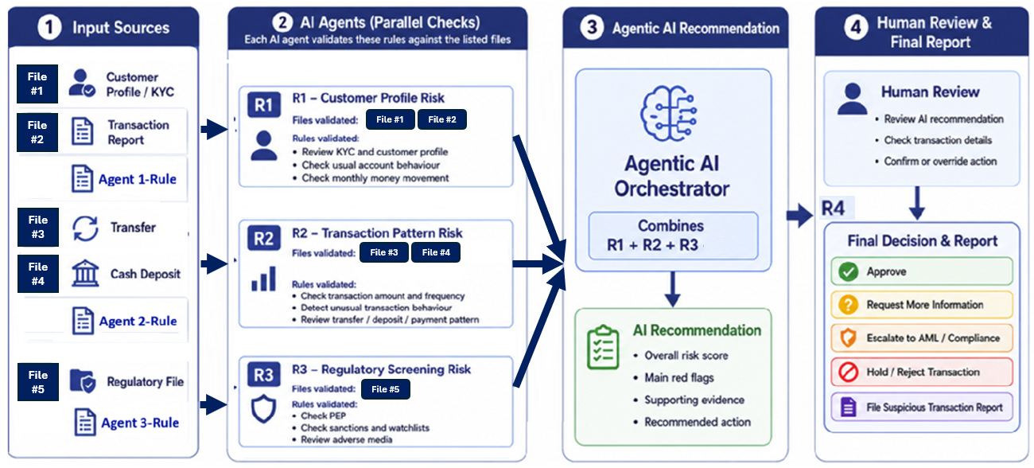
Logical Design

Slide 8
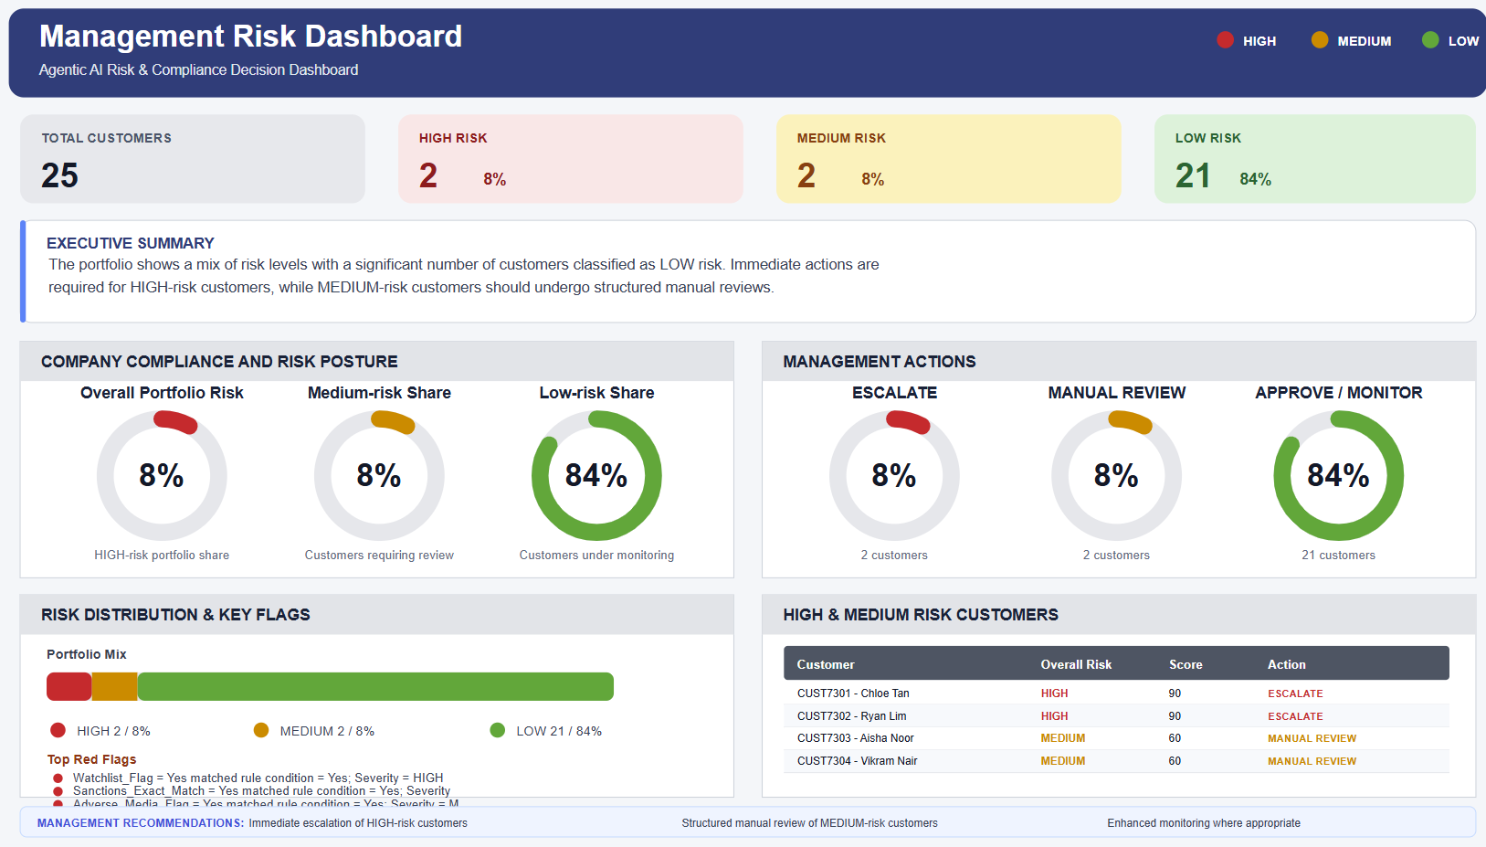

Slide 9
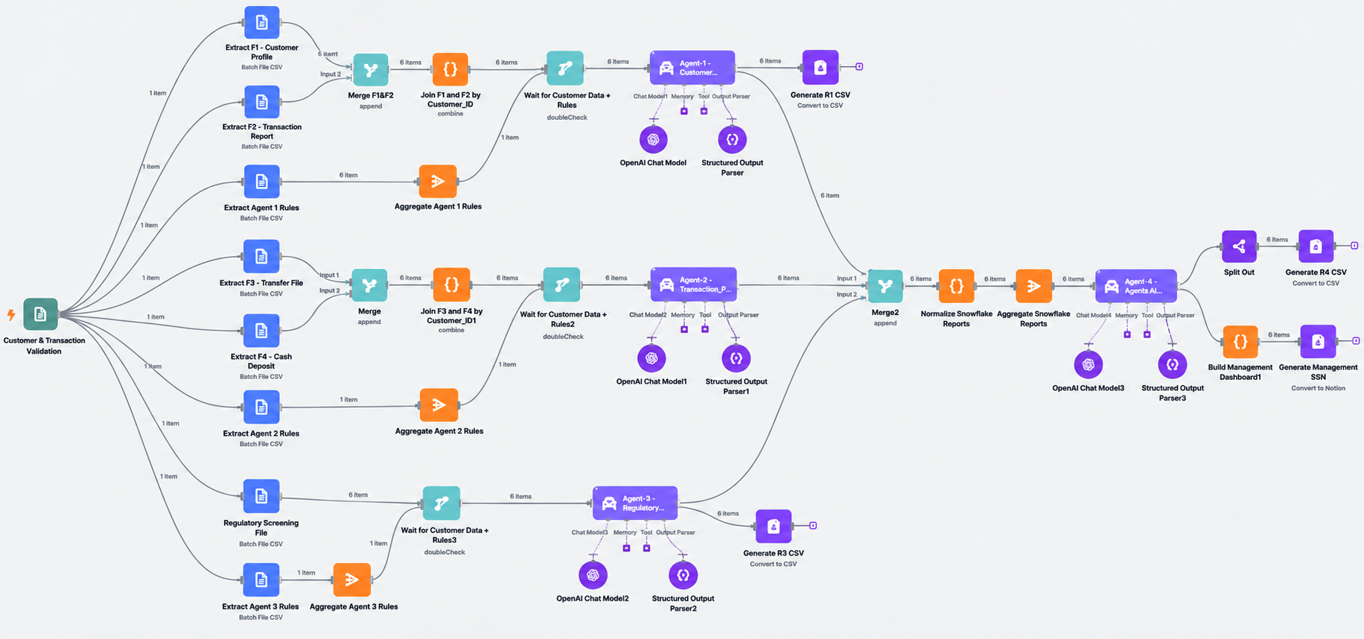
Stages of Agentic AI Risk Assessment Workflow Orchestration

Slide 10
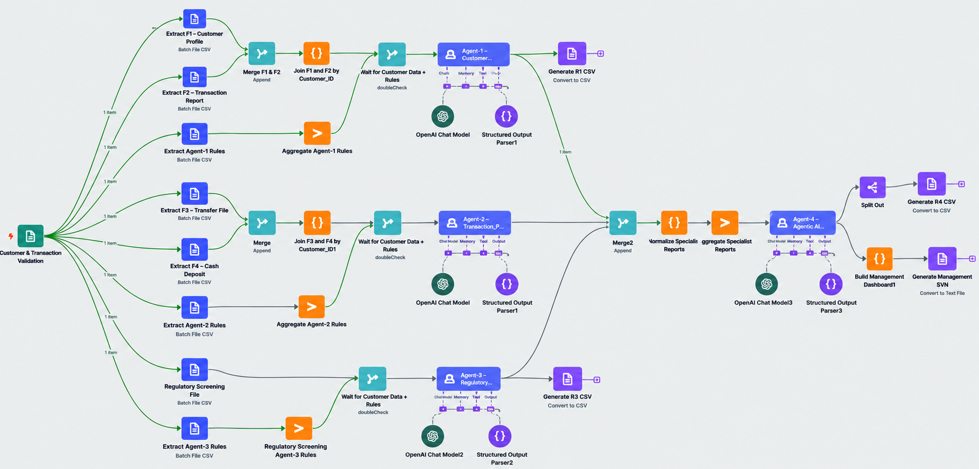
Agentic AI Risk Assessment Workflow Orchestration
Data Intake
Data Extraction
Data
Pre-Processing
AI Agent
Risk Assessment
Agentic AI
Orchestration and Reporting

Slide 11
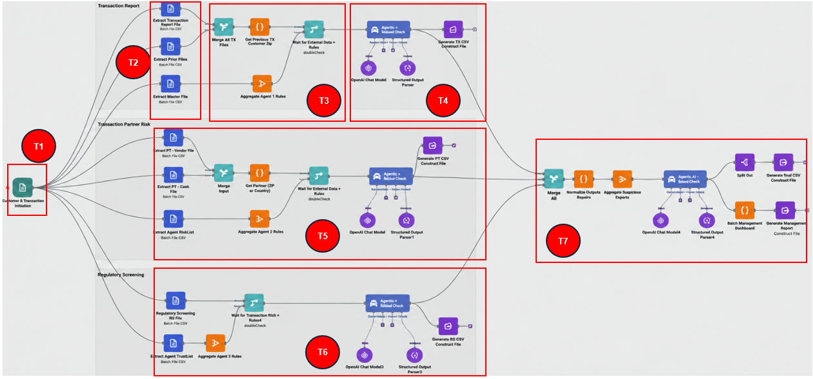
Agentic AI Risk Assessment Workflow (Tasks 1–7)
Merge and pre-process customer, transaction, and rule data
Configure
Agent-1 – Customer Profile Risk Assessment
Extract the required data
Configure the Agentic AI Orchestrator and generate the consolidated risk output and dashboard
Configure Agent-2 – Transaction Pattern Risk Assessment
Configure the Agent-1 file upload form
Configure Agent-3 – Regulatory Screening Risk Assessment

Slide 12

Lab 1 – Create Agent-1
Merge and pre-process customer, transaction, and rule data
Configure
Agent-1 – Customer Profile Risk Assessment
Extract the required data
Configure the Agent-1 file upload form

Slide 13
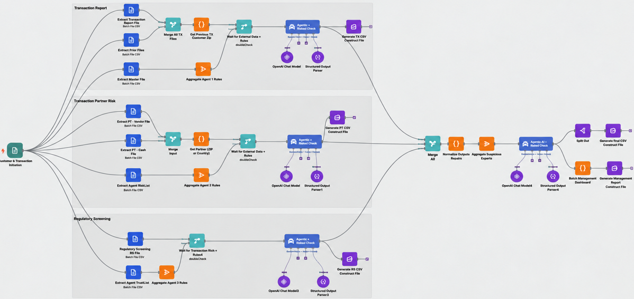



Lab 2 - Create Agent-2 & Agent-3
Configure Agent-2 – Transaction Pattern Risk Assessment
Configure Agent-3 – Regulatory Screening Risk Assessment

Slide 14

Lab 3 - Create Agentic AI Orchestrator
Configure the Agentic AI Orchestrator and generate the consolidated risk output and dashboard

Slide 16
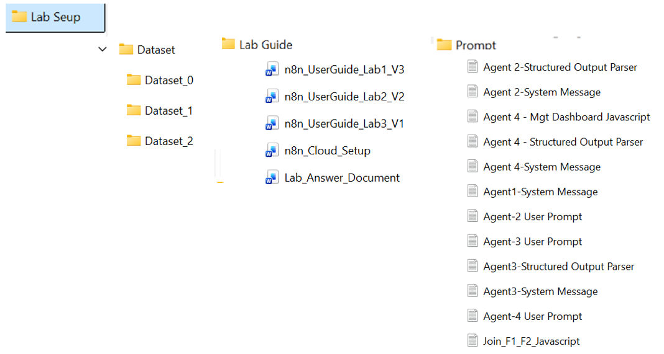
Lab Materials

Slide 17


Lab Deliverables
Lab | Task | Required Output | Expected File Type | Attachment
1 | 1, 2, 3, 4 | R1 - Customer Profile Risk Report | .csv
2 | 5, 6 | R2 - Transaction Pattern Risk Report R3 - Regulatory Screening Report | .csv
3 | 7 | R4 - Agentic AI Recommendation Report R4 - Management Risk Dashboard | .csv .svg

Slide 18
Gen AI Concepts for the DXS Banking Workflow
AI & GenAI Concepts Recap

Slide 19
Lab User Guide & Answer Guide Walkthrough

Slide 20
n8n Setup
What is n8n and Why are we using it in this lab?
n8n is a visual workflow automation platform that allows you to connect data, applications, business rules, and AI models into one automated process.
Instead of building a complete software application from scratch, you can create workflows by connecting nodes that perform tasks such as receiving files, preparing data, calling AI models, and generating outputs.
You need an n8n account because the lab workflow will be built, configured, tested, and executed inside the n8n workspace.
Step 1: Go to https://app.n8n.cloud/login
Step 2: Create your n8n Cloud account using Your Email account (Gmail/Yahoo/…)
Step 3: Verify Your Email
Step 4: Complete Your Account Details

Slide 21
n8n Setup
Note:
The n8n free trial expires after 2 weeks, so please complete the lab before the trial period ends.
New n8n Cloud trial accounts come with free AI Gateway credits that can be used with supported AI models, including OpenAI. These credits are sufficient to complete the lab exercises.

Slide 22


